Slide 1
Introduction to GitHub
May 2025
Presented by:
Sarah Blincko
Credit also to Chris Pottage and Fraser Blackman from the Strategic Analysis Team
Notes:
Fraser

Slide 2


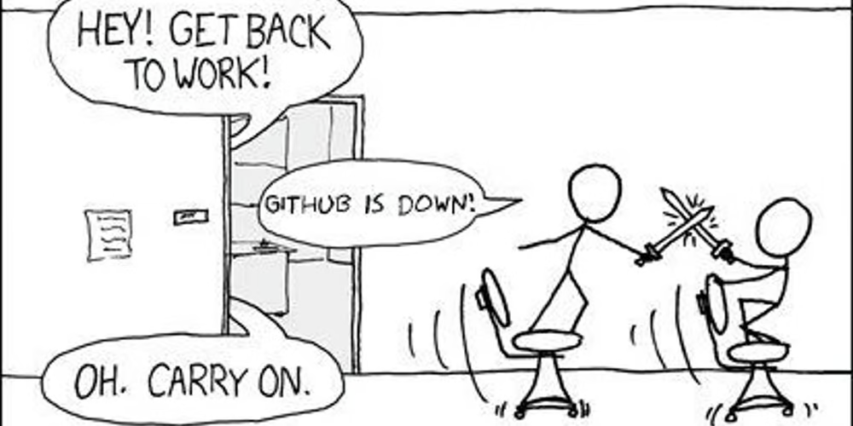
What is Git and GitHub?
GitHub is the world’s largest online repository hosting open source code projects.
GitHub allows users to collaborate on projects and share modifications. GitHub has, at its core, Git functionality, which allows for version control.
Slide taken from Health Service Modelling Associates Training Course
Notes:
Fraser

Slide 3
Why Use Git?
The government, and more recently the NHS, have heavily leaned into RAP - Reproducible Analytical Pipelines.
In a nutshell - and at a minimum - RAP involves:
“minimising manual steps through automation
using open-source languages to improve portability and reduce license fees
peer reviewing code to improve quality and reliability
using code version-control software (for example, Git) to improve auditability, change tracking and disaster recovery
publishing the code externally to improve transparency and reuse
documenting the code in-situ through comments and markdown files, to improve accessibility and understanding”
https://digital.nhs.uk/blog/data-points-blog/2023/why-were-getting-our-data-teams-to-rap
Slide taken from Health Service Modelling Associates Training Course
Notes:
Fraser

Slide 4
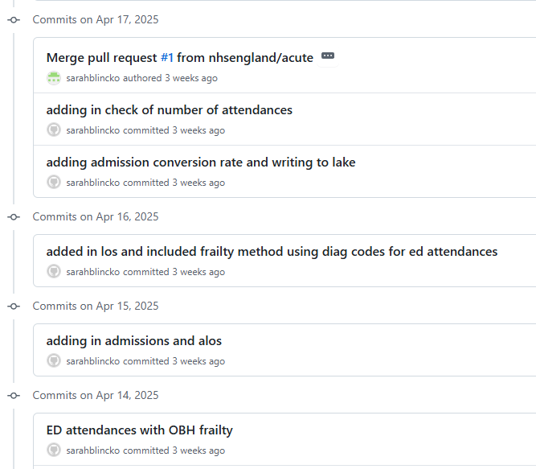
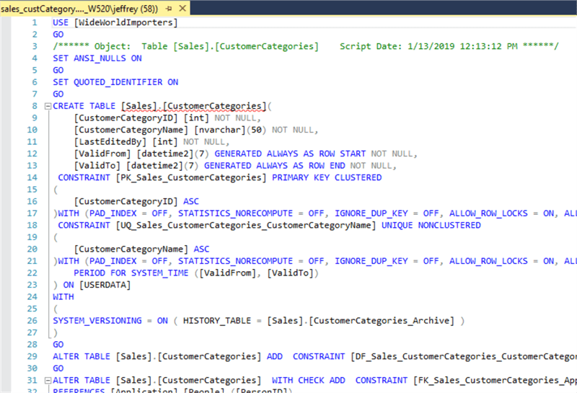
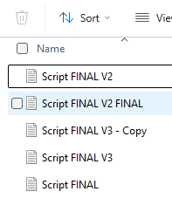
Example of why GitHub is useful to us
SQL script that is run monthly.
Multiple changes have been requested to this script.
Without GitHub, keeping track of changes could look something like this:
With GitHub, the record of changes made could look like this:
Which is the version to use?
Not easy to see what has changed between each version.
Only one version of the script but each change is recorded.
Older versions can easily be viewed and restored.
Clicking on each commit will show you a view that highlights exactly which parts have changed.

Slide 5
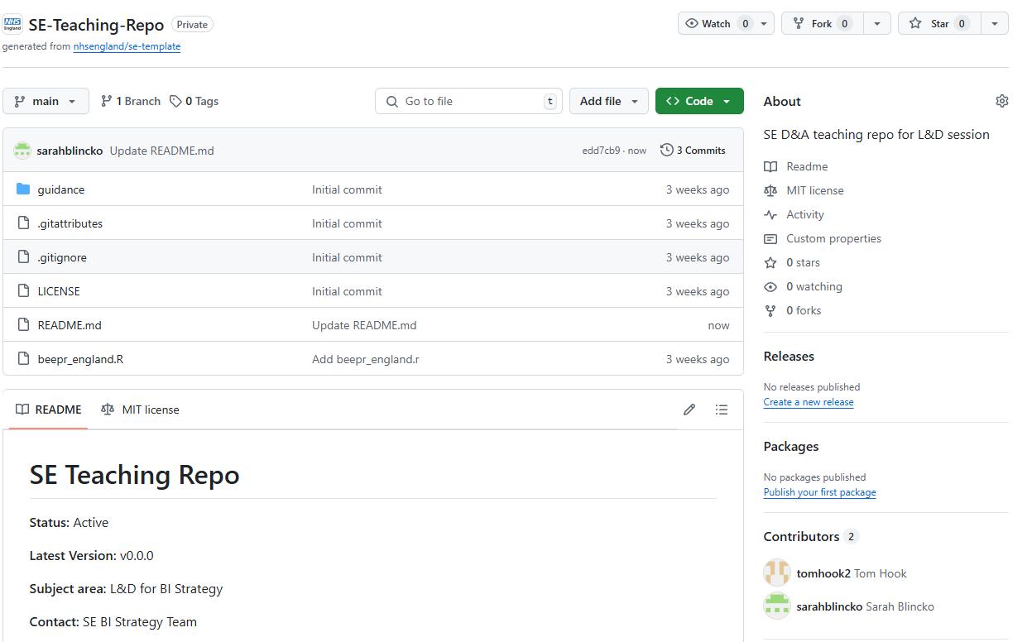
What is a repository?
A repository is a place that contains all your code and files
It is best practice to create a separate repository for each project.
Here is an example repository: the South East teaching repository that we will use as part of these sessions.
Notes:
Fraser

Slide 6
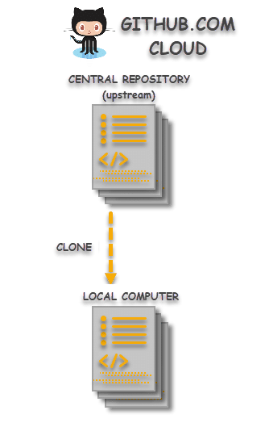


Cloning a repository
What is cloning a repository?
Cloning a Git repository means creating a local copy of a remote repository on your computer.
Once you have cloned a repository, you can start working on the project, making changes, and committing them to your local repository without changing the remote repository.
Why clone a repository?
Contribute to group projects - where multiple people work on the same code base, cloning enables individuals to edit the code without impacting on other users.
Make use of Open Source Repositories – enables you to use and edit functionality from other open source repositories.
Notes:
Sarah

Slide 7
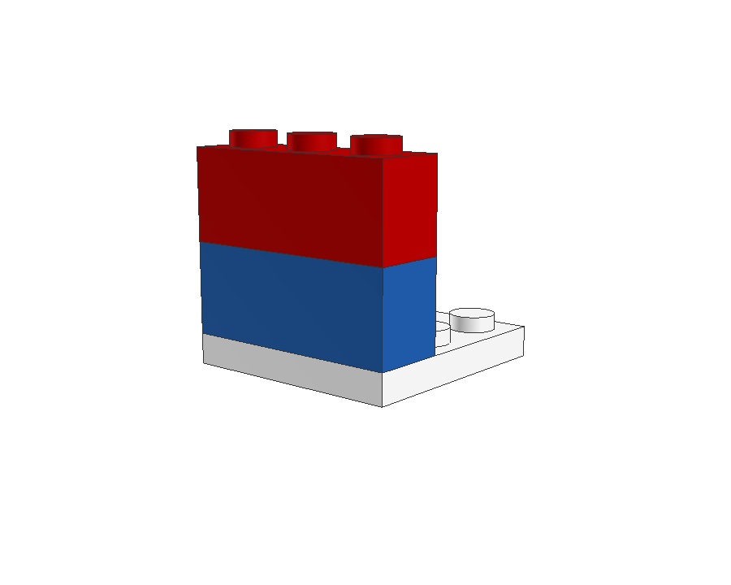
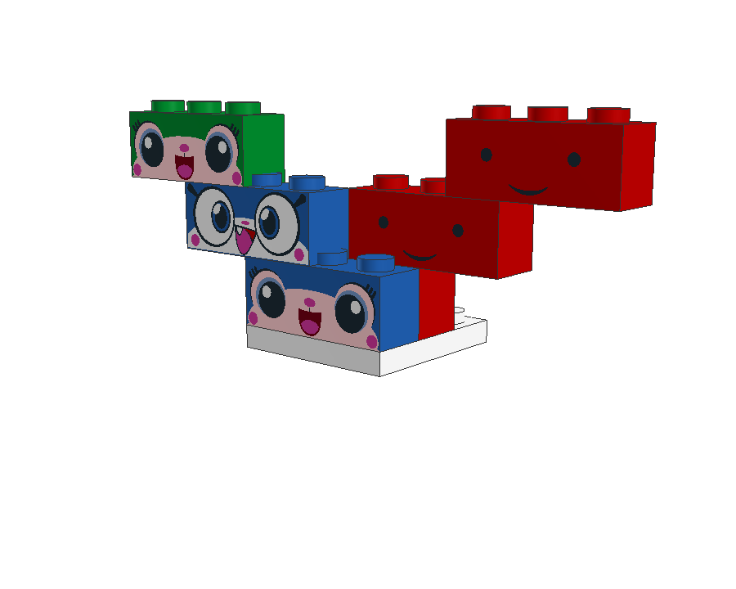

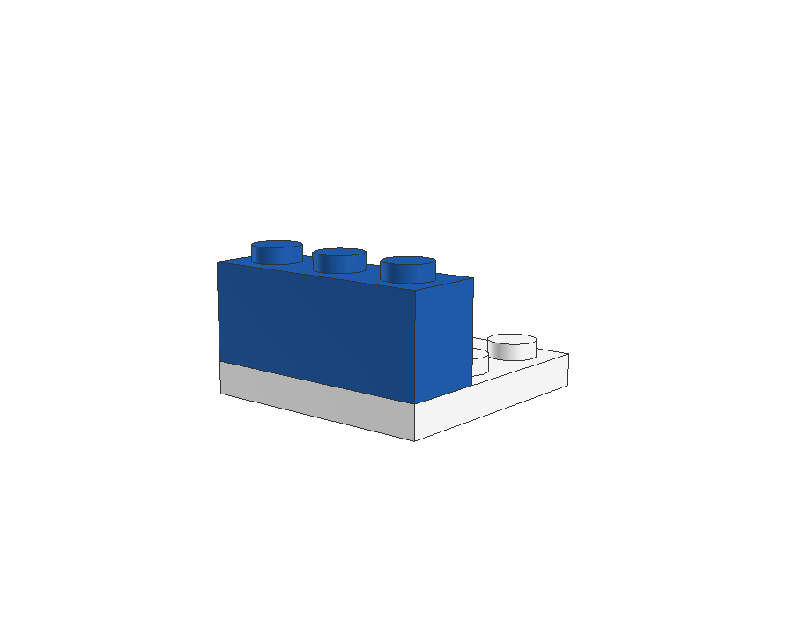
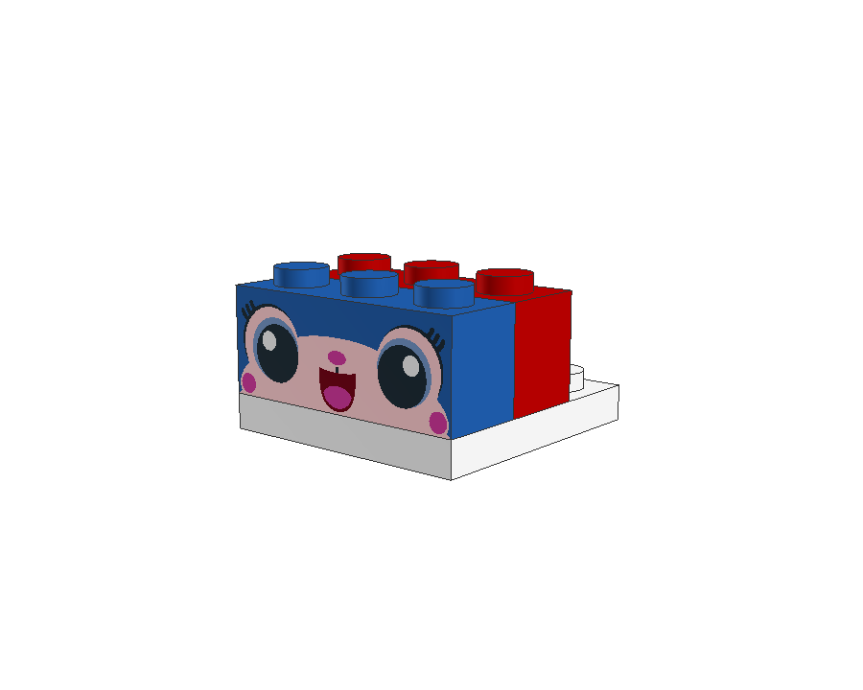
Branching
What is branching and why do we use it?
A branch is a new/separate version of the main repository. Branches allow you to work on different parts of a project without impacting the main repository. When the work is complete, a branch can be merged with the main repository.
Analogy (a non-tree version)
branch off
blue
(branch of a branch)
branch off main
(simple branch)
You can also create branches of branches which build out new features starting from the blue branch.
Here we add another brick called red on top of blue.
Based on these concepts you can develop several child branches based on the parent branches.
Once development of branches is complete, these are merged back up the tree to the main branch.
The main repository (the Lego base plate) branch.
Usually called the main (or historically master) branch
When you create a branch of main, you add a brick.
We called this branch blue.
This branch contains the history of the base plate plus any additional work on blue.
You can create multiple branches from the same branch. Useful when developing separate features.
In this example, we add a red brick on top of main and in parallel to blue.
branch off
main
(parallel branch)
Lego analogy: https://opensource.com/article/22/4/git-branches
Notes:
Sarah

Slide 8

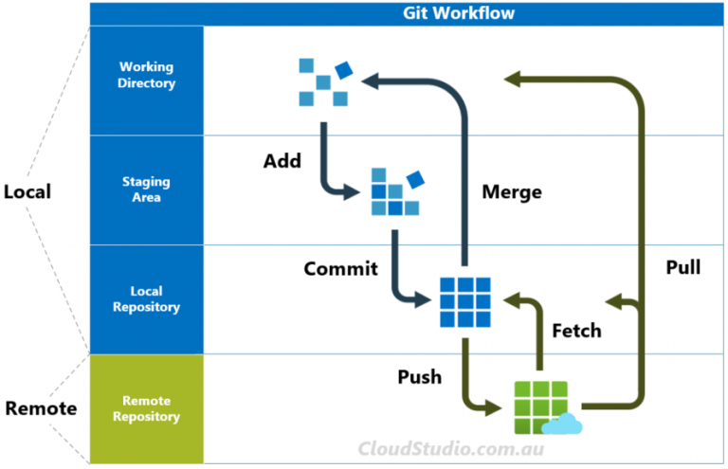
Fetching
This step is important to do to make sure your local version is up to date with changes others have made to the repository.
Fetch allows you to review what changes have been made in the remote repository before adding those changes to your local version.
The alternative option is to pull. However, this automatically makes those changes from the remote repository to your local version.
Fetch is the safer option so you can see what the changes are before adopting them.
Notes:
Sarah

Slide 9
Staging, Committing and Pushing
Once you have made a change to a script you stage it, then commit it, and then finally push it to the remote repository.
Before staging/committing/pushing files, check there isn’t anything sensitive that shouldn’t be shared. E.g. Data or outputs!
Staging allows you to group changes to different scripts that are related so they have the same commit description.
You may choose not to push committed changes immediately, e.g. you are still in the middle of making changes to scripts but you want to keep a record of the steps you took through several commits.
Stage
Staged changes
Notes:
Sarah

Slide 10
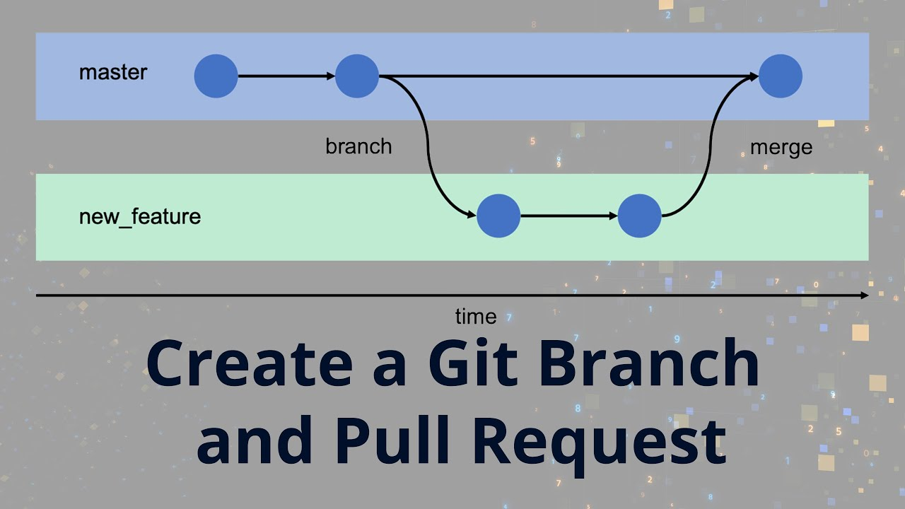
Pull Requests
A pull request is how you make a request to merge a branch to another branch, e.g. main.
If there are no conflicts, you are able to merge the branch to main.
If there are conflicts, you have to resolve them before you can merge the branch to main.
main
Pull request and then merge branch to main
Notes:
Sarah

Slide 11
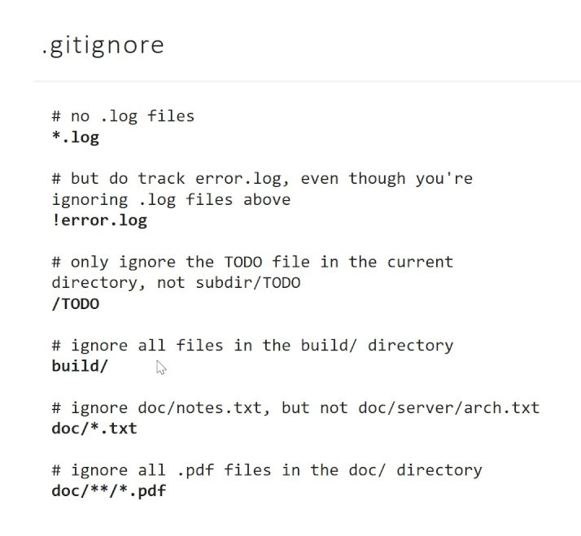
.gitignore file
A .gitignore file is a plain text file that contains a list of all the specified files and folders from the project that Git should ignore and not track, e.g. data or your outputs.
Inside .gitignore, you can tell Git to ignore only a single file or a single folder by mentioning the name or pattern of that specific file or folder. You can also tell Git to ignore multiple files or folders using the same method.
Your repository should always have a .gitignore file in
the root folder - the current SE D&A template repository
.gitignore file should cover most of what you may need.
Example of a .gitignore file
Notes:
Chris

Slide 12
Platforms that can use GitHub
Databricks (PySpark) – guide
RStudio (R) – guide
Visual Studio Code (SQL, Python) – guide
Notes:
Chris

Slide 13
Task 1
Using Databricks and this guide:
Clone the SE teaching repo: https://github.com/nhsengland/SE-Teaching-Repo
  (This is a private repo we created for our team as a playground for learning. If you are looking to do a similar task with your own team, we would recommend creating a similar repo using our template and adding some code files you don’t mind your team playing around with)
Create your own branch
Make a change to any of the existing files e.g. add a comment with your name, add a line of code, change an existing comment
Add in a new file
Commit and push through your changes
Switch to the main branch again
Notes:
Chris

Slide 14
Task 2
Using this guide create your own repo for an existing piece of work you are likely to migrate to GitHub or for a new piece of work you will be working on. You can use GitHub desktop for this or the GitHub website.
Update the readme file for the piece of work
Choose if you work will use RStudio/Databricks/VS Code
Clone the repo using the relevant guide for RStudio/Databricks/VS Code
Create a branch
Add a file and add a comment describing what this file is for
Commit and push through your changes
Switch to the main branch again
Notes:
Chris

